Slide 1
NODE.JS
(The Backend Of MERN Stack)
Lecture 40

Slide 2
Today’s Agenda
Introduction To Express Router
Using Express Router
Configuring Multiple Routers
Adding Middleware To Specific Router
Examples

Slide 3
Problem in our approach
Till now in every API example we have defined all the routes in app.js.
This makes the file quite long and hard to read.
As we add functionality to an application, this file would get long and cumbersome.

Slide 4
Introduction to express router
The solution to this is to use Express Router.
Express Router is a way to organize our Express application such that our primary app.js file does not become bloated and difficult to read.

Slide 5
Introduction to express router
Routers are like mini versions of Express applications.
They provide functionality for handling route matching, requests, and sending responses, but they do not start a separate server or listen on their own ports.
Routers use all the .get(), .put(), .post(), and .delete() routes that we are now familiar with.

Slide 6
Using express router
To use Express Router we need an object of Router class .
To get this object we call the method Router() on top level express object.

Slide 7
Steps required
To use Express Router we need to take following steps:
Define a separate .js file
Import express in it.
Obtain an object of Router class by calling the method Router() on express object.
Using the Router object define all the routes just like we did previously in app.js.
Export the Router object.
Now in app.js import the Router object.
Pass this Router object as middleware to the app.use() method
This router will now be used for all path requests.

Slide 8
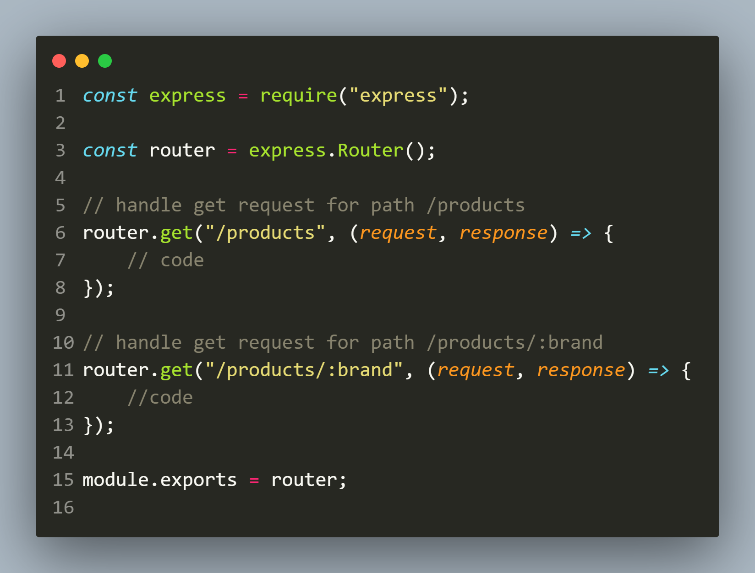
Defining routes.js

Slide 9
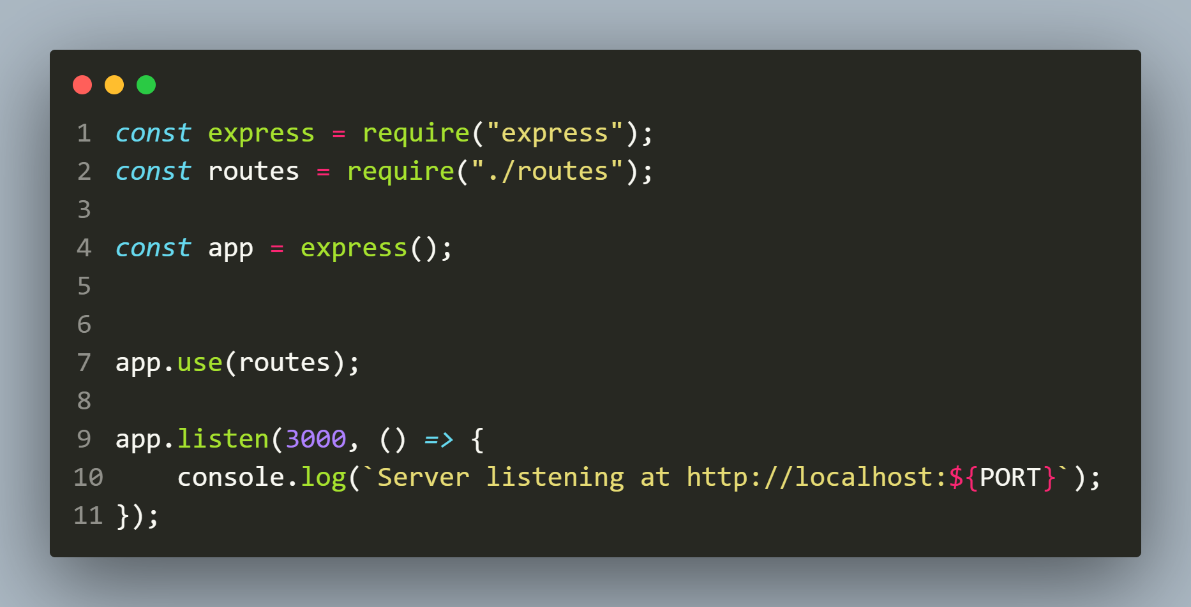
Defining app.js

Slide 10
Exercise 83
Create an Express application to do the following:
Create a file called products.js containing an array holding details of 3 products :
let products = [
{ id: 101, name: “Iphone”, price: 70000 },
{ id: 102, name: “Ipad”, price: 52000 },
{ id: 103, name: “Iwatch”, price: 36000 },
];

Slide 11
Exercise 83
Now create another file called router.js and write code for handling 2 GET request and 1 POST request
The GET request for “/api/products” should return the full details of all 3 products
The GET request for “/api/products/:productID” should return details of the productid passed

Slide 12
Exercise 83
The POST request should accept product name and price and add the new product to the products array.
Finally it should return a JSON object containing the message product added along with the new id of the product
Lastly create the file app.js and write code for setting up the router as well as starting the server.

Slide 13
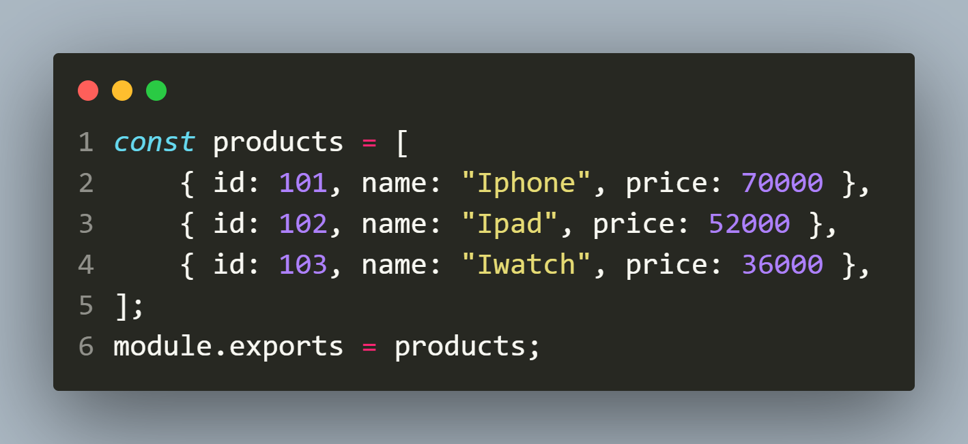
Solution (products.js)

Slide 14
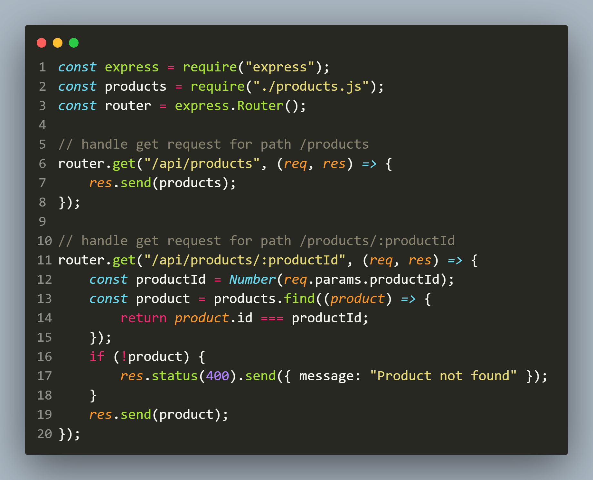
Solution (routes.js)

Slide 15
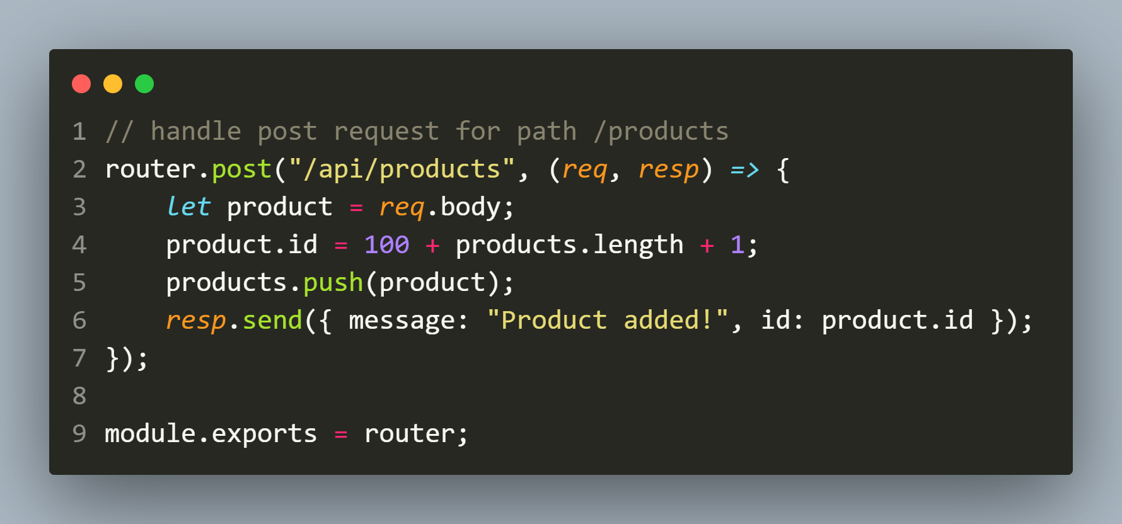
Solution (routes.js)

Slide 16
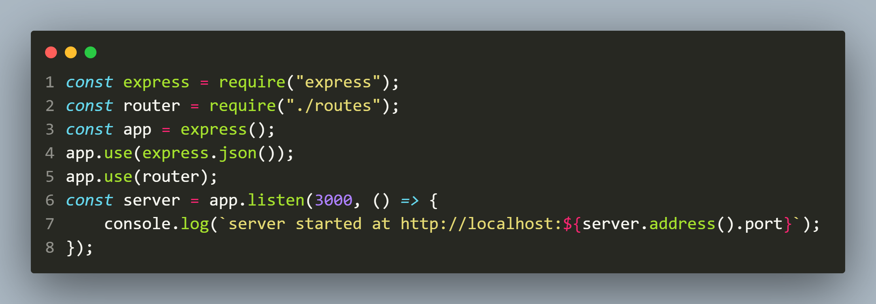
Solution (app.js)

Slide 17
Improvising the code
We can make the previous code much better by passing the path “/api/products” as first argument to the method app.use() and router object as the second argument.
In this way we will have to set the path only at one place while route handling will still be done by router.js separately

Slide 18
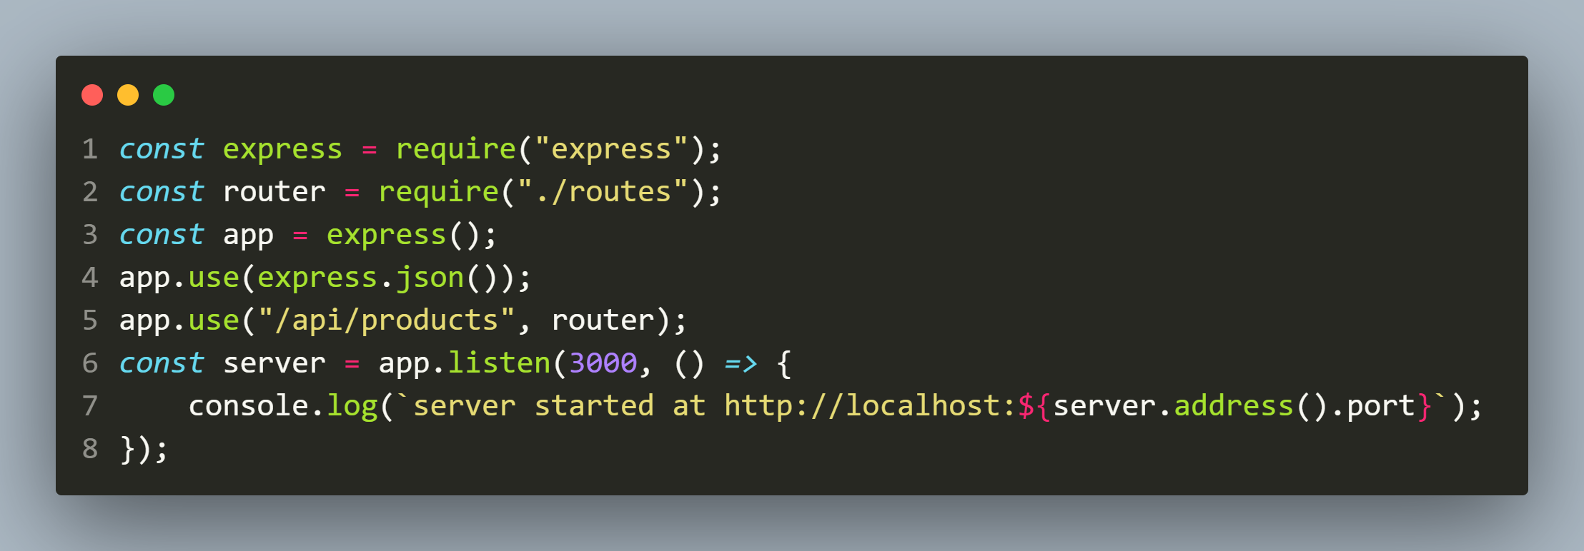
Modified app.js

Slide 19
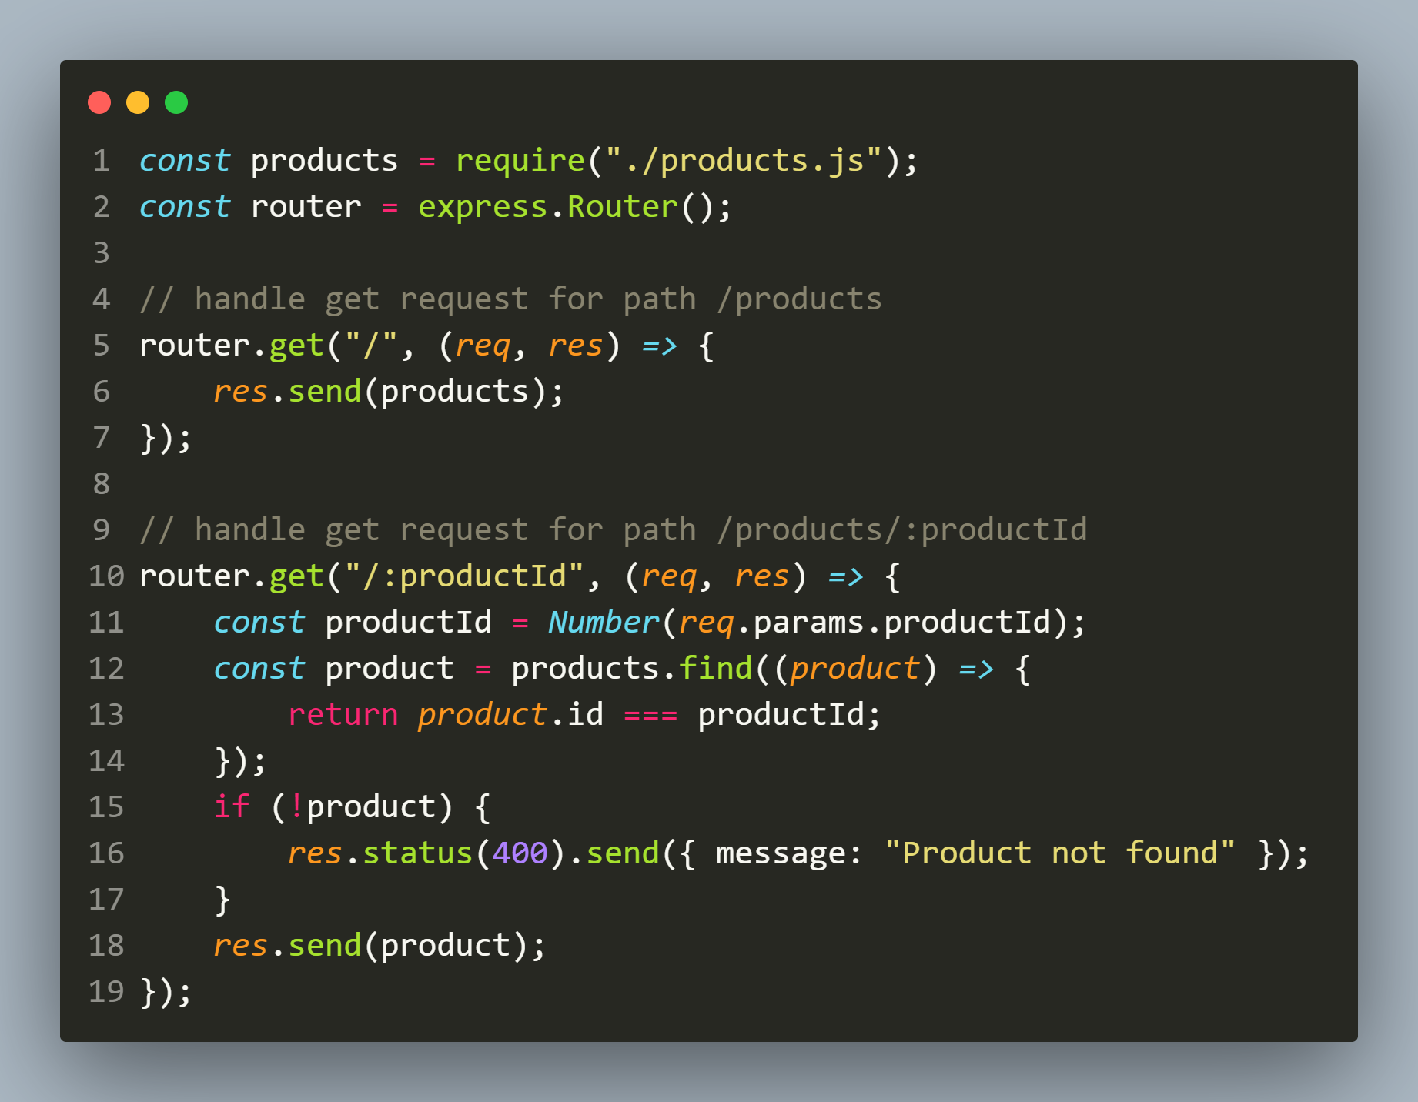
modified routes.js

Slide 20
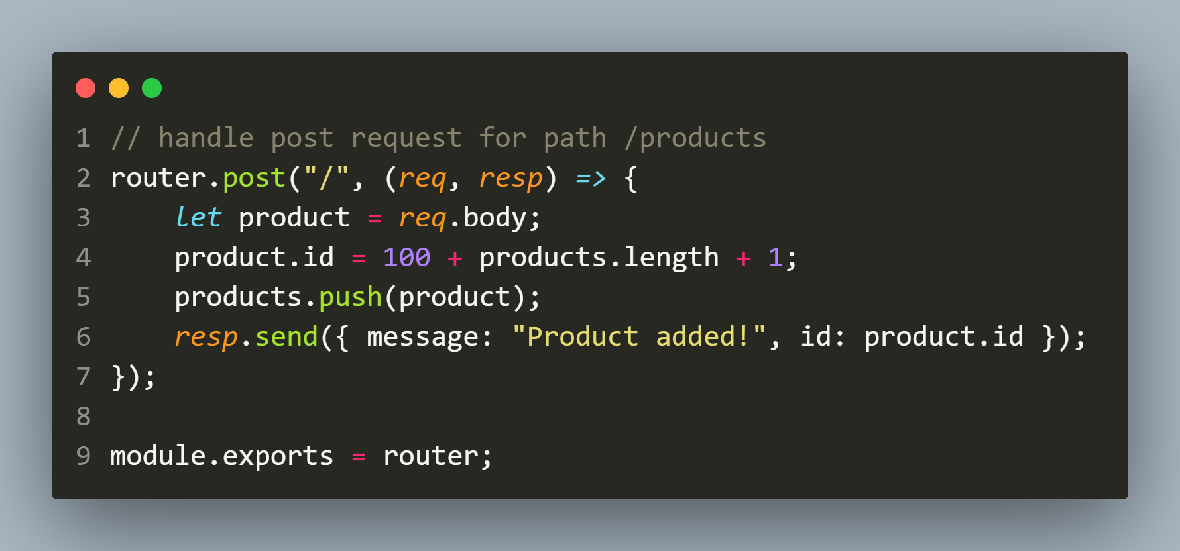
modified routes.js

Slide 21
Configuring multiple routers
Our application may have multiple api entity endpoints.
For example, we may have a product api as well as an employee api.
So as per industry standards we must code routes for both the api endpoints in their separate router files.
This helps to keep our code clean and our files short.

Slide 22
Exercise 84
Create an Express application for handling GET and POST request for two api endpoints: /api/products and /api/employees .
Set up route handlers for both in their separate router files and use industry best practices to configure your application.

Slide 23
Solution (/data/products.js)

Slide 24
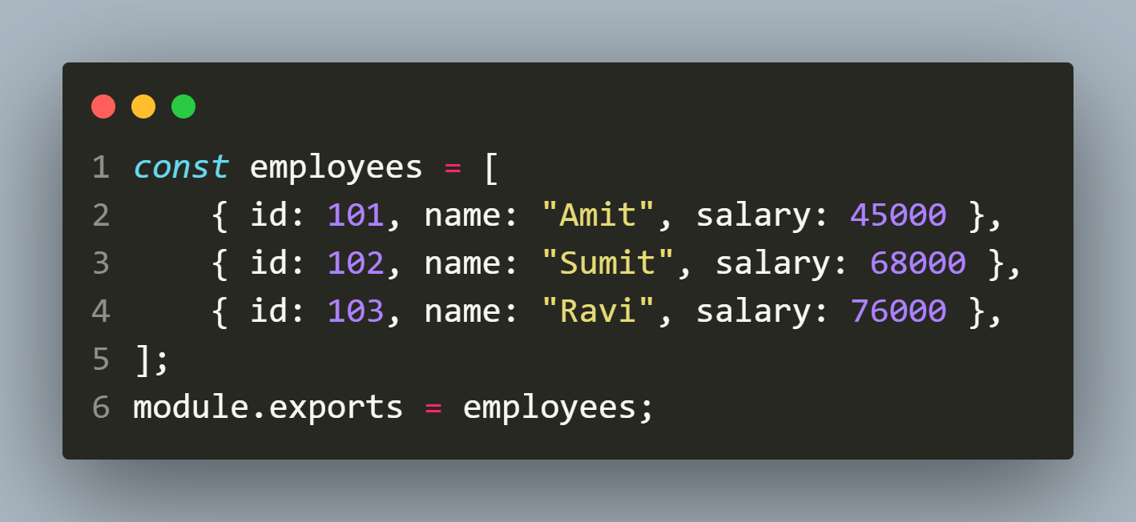
Solution (/data/employees.js)

Slide 25
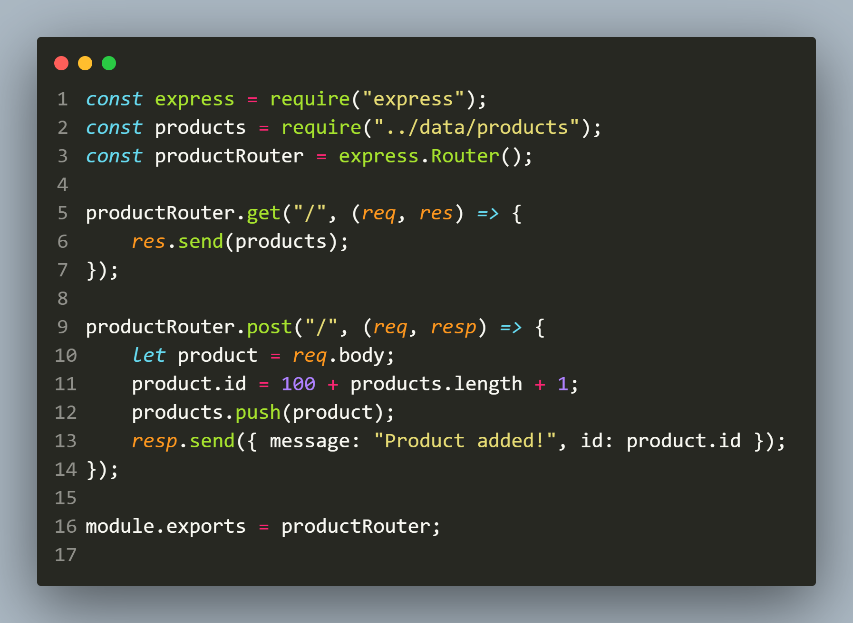
Solution (routes/productRoutes.js)

Slide 26
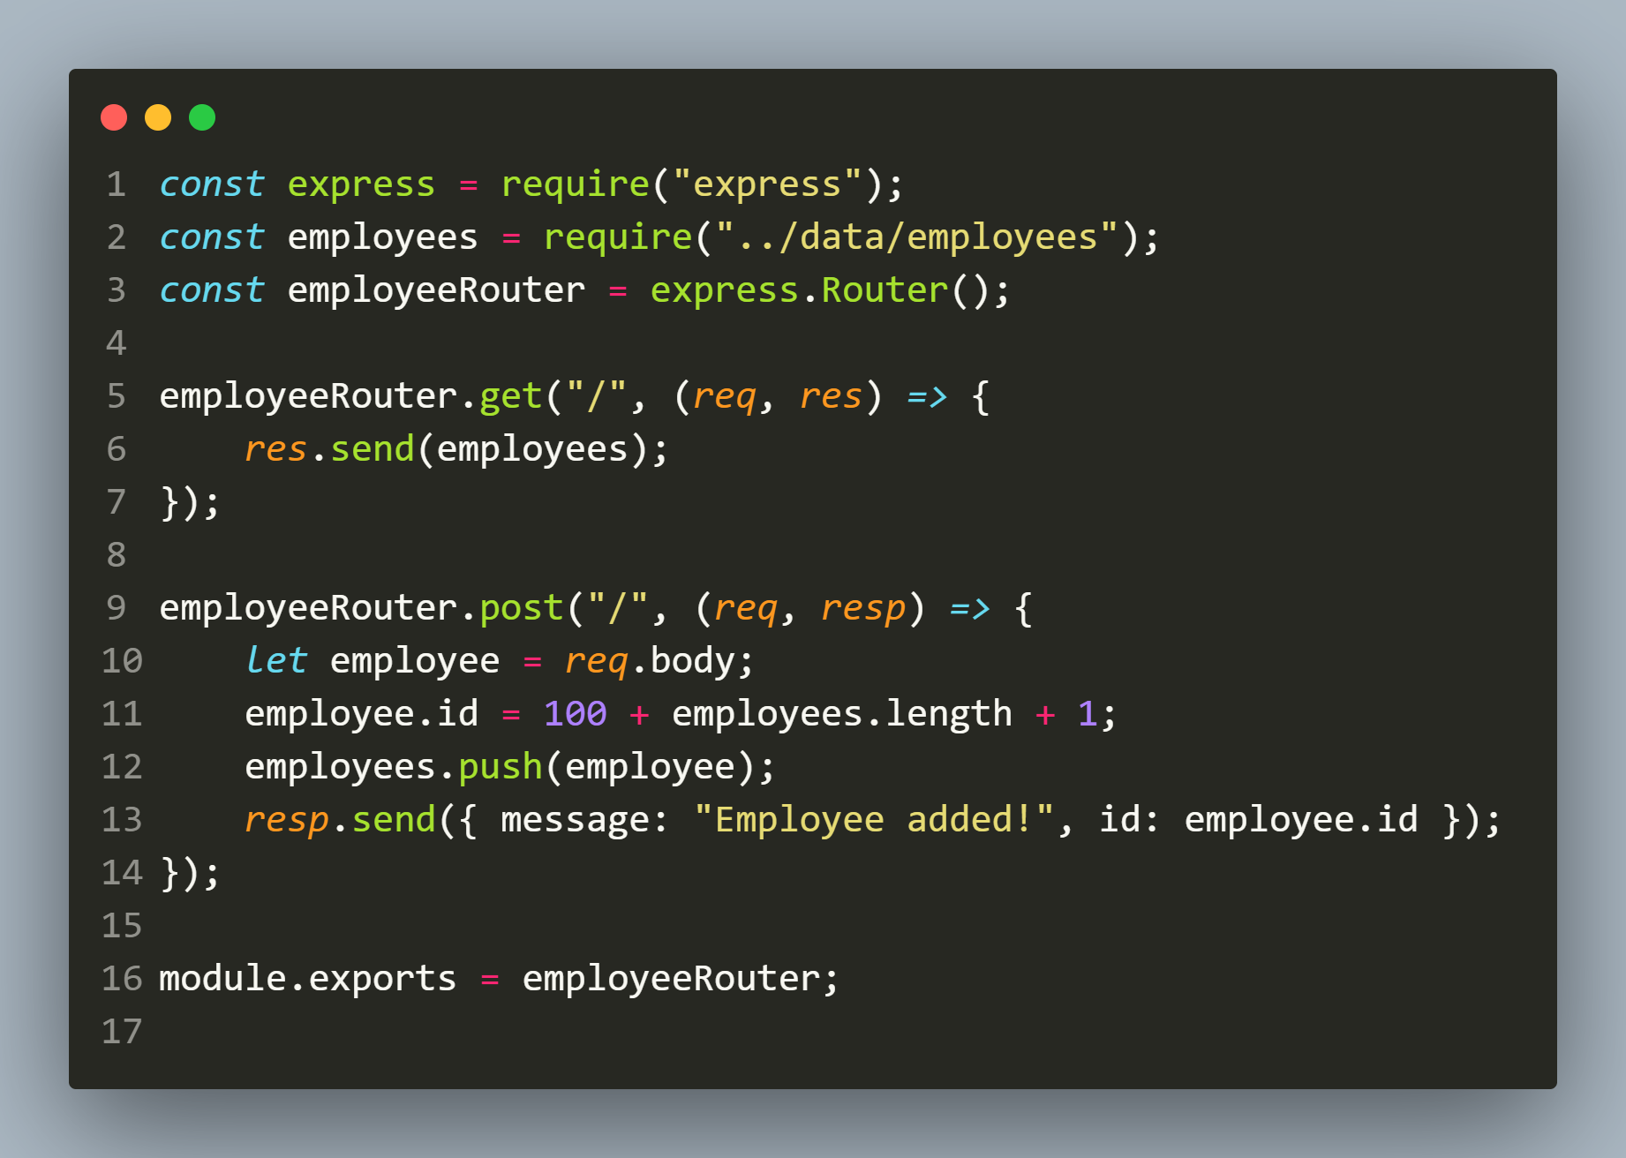
Solution (routes/employeeRoutes.js)

Slide 27
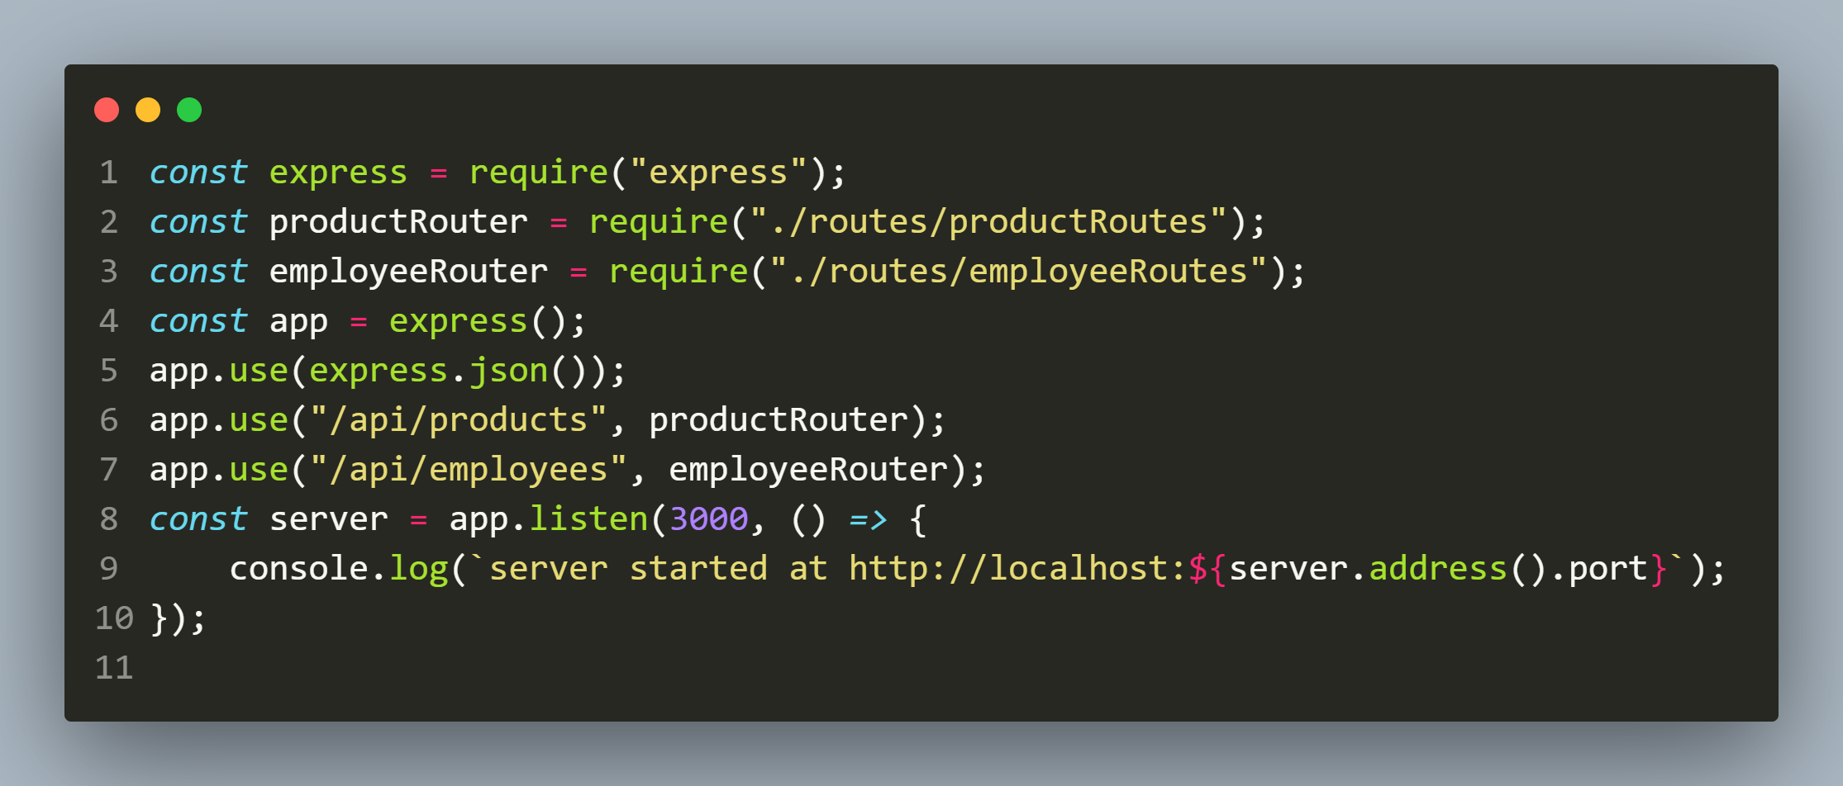
Solution (app.js)

Slide 28
Adding middleware to router
Express allows us to add some middleware functionality only to a specific router.
In this way the middleware will only run when the request arrives for that route.

Slide 29
Adding middleware to router
For example we can set a logger middleware which logs the request date and time on console but only when the request arrives for /api/products route.
To do this we simply have take 2 steps:
Define the middleware function in the productsRouter.js file.
Call the use() method on Router object and pass the middleware function as argument.

Slide 30
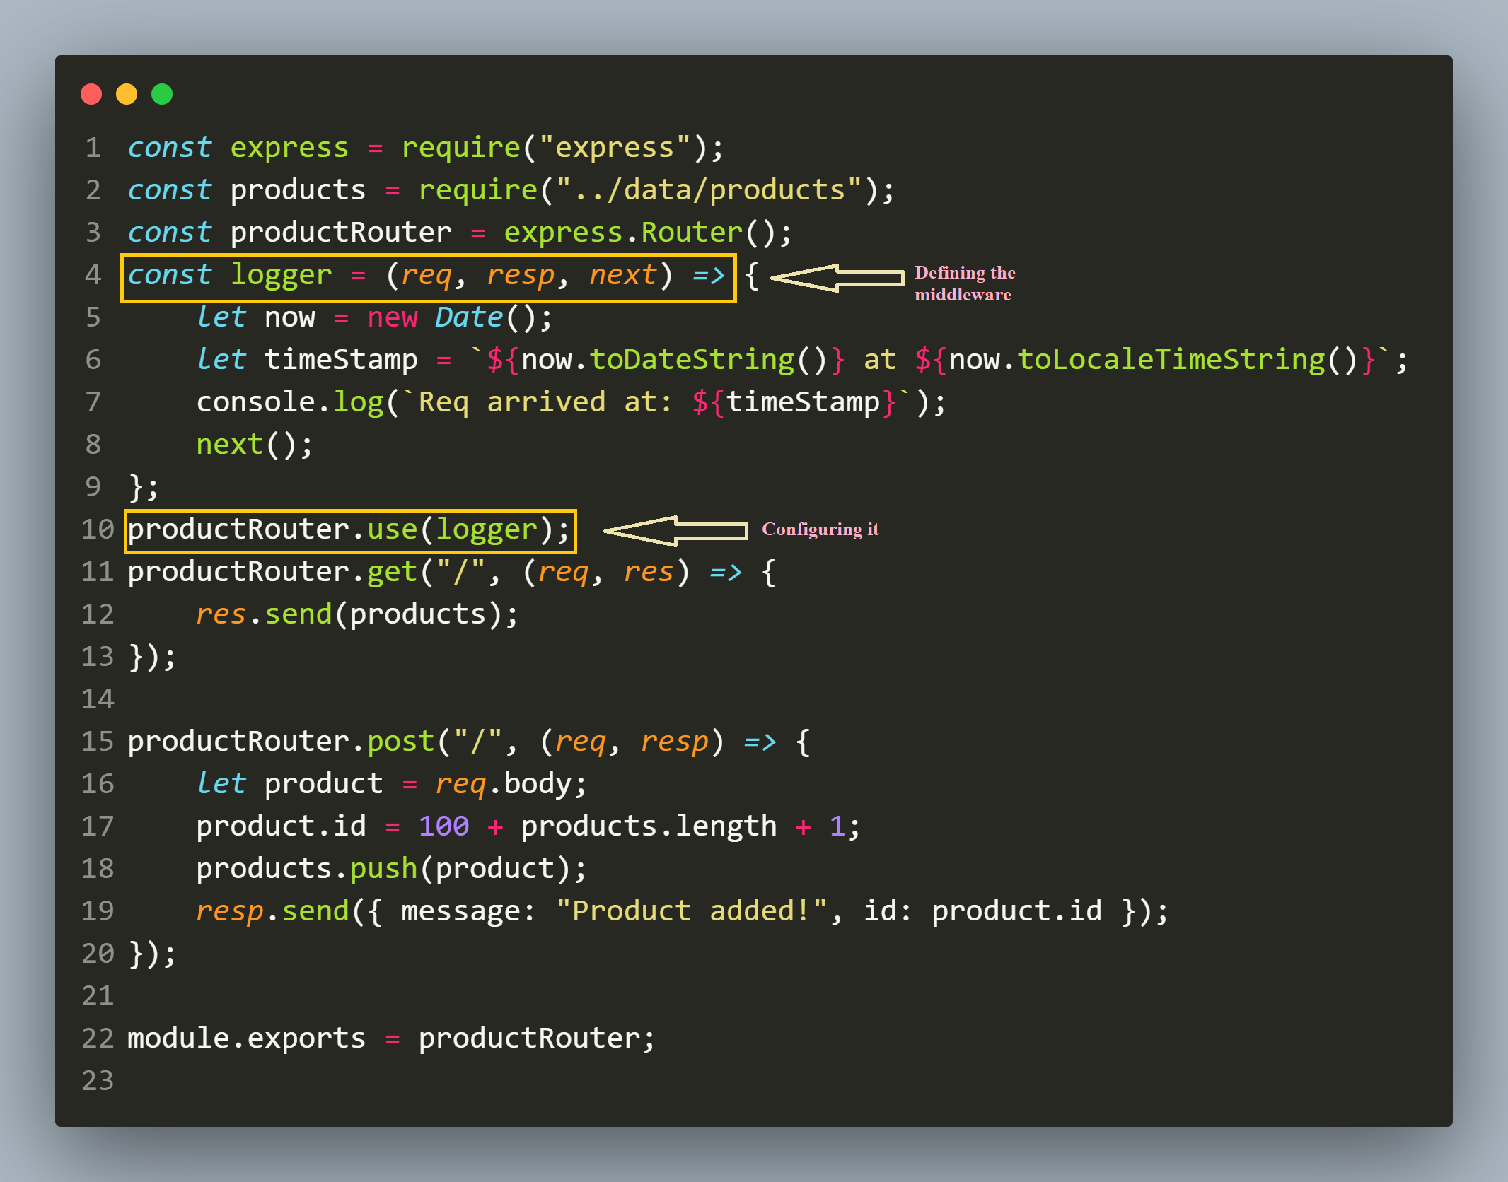
modified (routes/productRoutes.js)

